Slide 1
Mass-Storage Systems
Disk Structure
Disk Scheduling
Disk Management
Swap-Space Management
RAID Structure

Slide 2
Disk Structure

Slide 3

Main form of secondary storage is the disk
– each disk has multiple magnetic platters
– each platter has up to two surfaces
– each surface has 20 to 1500 tracks per surface
• Vertical arrangement of tracks into cylinders
– each track contains multiple sectors
– example: 1.2 Gigabyte Disk
• 63 sectors/track, 512 bytes/sector
• 618 cylinders, 64 heads
– example: 1.44 Megabyte floppy
• 80 cylinders, 512 bytes/sector,
• 36 sectors/track

Slide 4
Disk Scheduling
The operating system is responsible for using hardware efficiently — for the disk drives, this means having a fast access time and disk bandwidth.
Disk scheduling: is a process of decide head is move to which track
Access time has two major components
  Seek time: The amount of time it takes the Read/Write heads to travel from their current cylinder location to a new cylinder
  Rotational latency: The time it takes for a specific block of data on a data track to rotate around to the read/write head
Minimize seek time
Disk bandwidth : is the total number of bytes transferred, divided by the total time between the first request for service and the completion of the last transfer.

Slide 5
Disk Scheduling
Several algorithms exist to schedule the servicing of disk I/O requests.
1. FCFS ( First Come First Server)
2. SSTF ( Shortest Seek Time First)
3. Scan Algorithm
4. C Scan Algorithm ( Circular Scan)
5. Look Algorithm
6. C Look Algorithm
We illustrate them with a request queue (0-199).
98, 183, 37, 122, 14, 124, 65, 67
Head pointer 53

Slide 6

FCFS
This method tracks are served as FCFS basic i.e the first track request is
To be first serviced

Slide 7
SSTF
Selects the request with the minimum seek time from the current head position.
SSTF scheduling is a form of SJF scheduling; may cause starvation of some requests.
Illustration shows total head movement of 236 cylinders.

Slide 8

SSTF

Slide 9
SCAN
The disk arm starts at one end of the disk, and moves toward the other end, servicing requests until it gets to the other end of the disk, where the head movement is reversed and servicing continues.
Sometimes called the elevator algorithm.
Illustration shows total head movement of 208 cylinders.

Slide 10
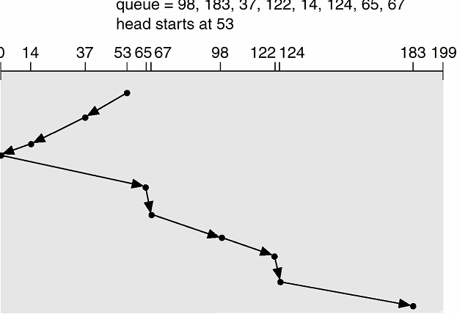
SCAN

Slide 11
C-SCAN
Provides a more uniform wait time than SCAN.
The head moves from one end of the disk to the other. servicing requests as it goes. When it reaches the other end, however, it immediately returns to the beginning of the disk, without servicing any requests on the return trip.
Treats the cylinders as a circular list that wraps around from the last cylinder to the first one.

Slide 12

C-SCAN

Slide 13
C-LOOK
Version of C-SCAN
Arm only goes as far as the last request in each direction, then reverses direction immediately, without first going all the way to the end of the disk.

Slide 14

C-LOOK

Slide 15
Swap-Space Management
Swap-space — Virtual memory uses disk space as an extension of main memory.
Swap-space can be carved out of the normal file system,or, more commonly, it can be in a separate disk partition.
Swap-space management
  4.3BSD allocates swap space when process starts; holds text segment (the program) and data segment.
  Kernel uses swap maps to track swap-space use.
  Solaris 2 allocates swap space only when a page is forced out of physical memory, not when the virtual memory page is first created.

Slide 16
RAID Structure
RAID – multiple disk drives provides reliability via redundancy.
RAID is arranged into six different levels.

Slide 17
RAID (cont)
Several improvements in disk-use techniques involve the use of multiple disks working cooperatively.
Disk striping uses a group of disks as one storage unit.
RAID schemes improve performance and improve the reliability of the storage system by storing redundant data.
  Mirroring or shadowing keeps duplicate of each disk.
  Block interleaved parity uses much less redundancy.

